Slide 1
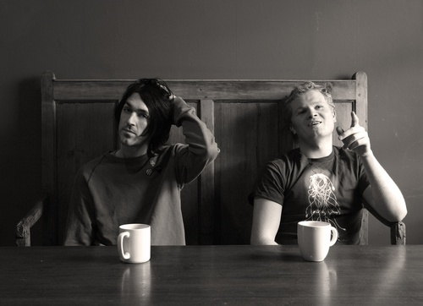
Duologues & sCENES
Drama
Year 9
Lesson 8

Slide 2
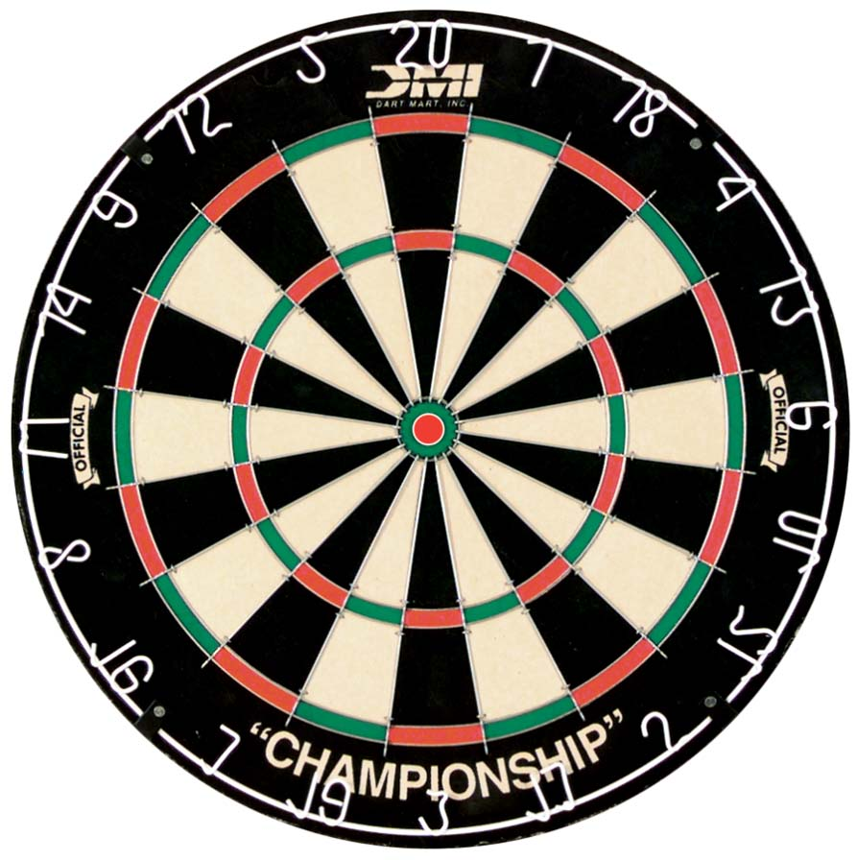
LESSON AIM
To Self Evaluate your own performance during the Duologues and Scenes scheme of work.

Slide 3
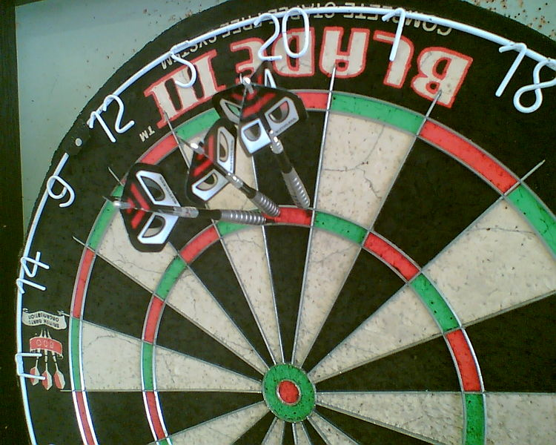
LESSON OUTCOME
LEVEL 4 - All students will know what self-evaluation is.
LEVEL 5 - Most students will understand why we self-evaluate our own work.
LEVEL 6 - Some students will be able to identify what they need to do to improve after reflecting upon their self evaluation.

Slide 4
LEVEL DESCRIPTORS
MAKING
LEVEL 4
I share my ideas and listen to others.
I can use the drama techniques to make my drama understandable to an audience.
LEVEL 5
When working in a group I can offer appropriate ideas.
My ideas are developed to show the deeper meanings to an audience.
LEVEL 6
I confidently share my ideas to my group and use props,
space (proxemics), lights and sound when I am devising a
piece of drama.
I am able to use some abstract drama in my work.

Slide 5
LEVEL DESCRIPTORS
PERFORMING
LEVEL 4
I stay in role for most of the performance.
I can confidently use Thought Tracking and the Layers of Meaning and make my answers detailed and connected to the drama.
LEVEL 5
I stay in role for the whole of the performance.
I can use most techniques appropriately.
I can sometimes use music, lighting and significant objects in my performance.
LEVEL 6
I change the tone of my voice appropriate to the character
and I am believable. I can use drama techniques to make
the drama more effective.

Slide 6
LEVEL DESCRIPTORS
RESPONDING
LEVEL 4
I can use the drama keywords when I evaluate and suggest how the group could improve their piece of drama.
LEVEL 5
When I evaluate I can recognise the strengths and weaknesses of the different performances and I can suggest improvements using the drama keywords.
LEVEL 6
When I evaluate I can confidently highlight and describe the strengths by using the drama key words. I can also clearly identify where the performance needs direction and can confidently suggest ways for improving.

Slide 7
SELF-EVALUATION
Fill in your self-evaluation form in your neatest handwriting.
Ask the teacher if you need any help.

